Slide 1
Data Base PostgreSQL
Pavel Vrublevskij

Slide 2
PostgreSQL
https://www.postgresql.org/download/
I recommend to have pgAdmin (could be last version) for advanced view of DDL. IntelliJ or other IDEA does not show important information of DDL

Slide 3
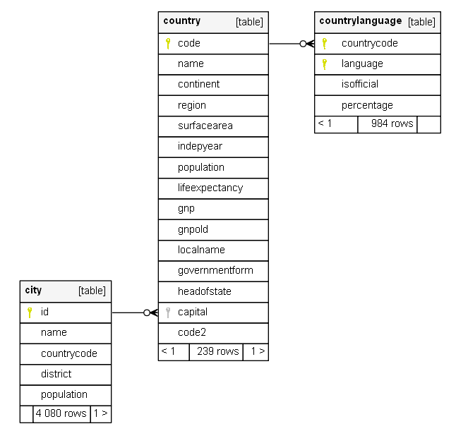
Get some test data
File ->

Slide 4
Create database
Open IntelliJ, create Database project
or
Open pgAdmin
Execute:
CREATE DATABASE world WITH OWNER = root -- write your owner name ENCODING = 'UTF8' TABLESPACE = pg_default LC_COLLATE = 'Lithuanian_Lithuania.1257' LC_CTYPE = 'Lithuanian_Lithuania.1257' CONNECTION LIMIT = -1;

Slide 5
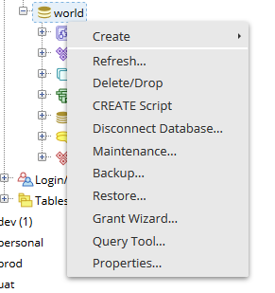
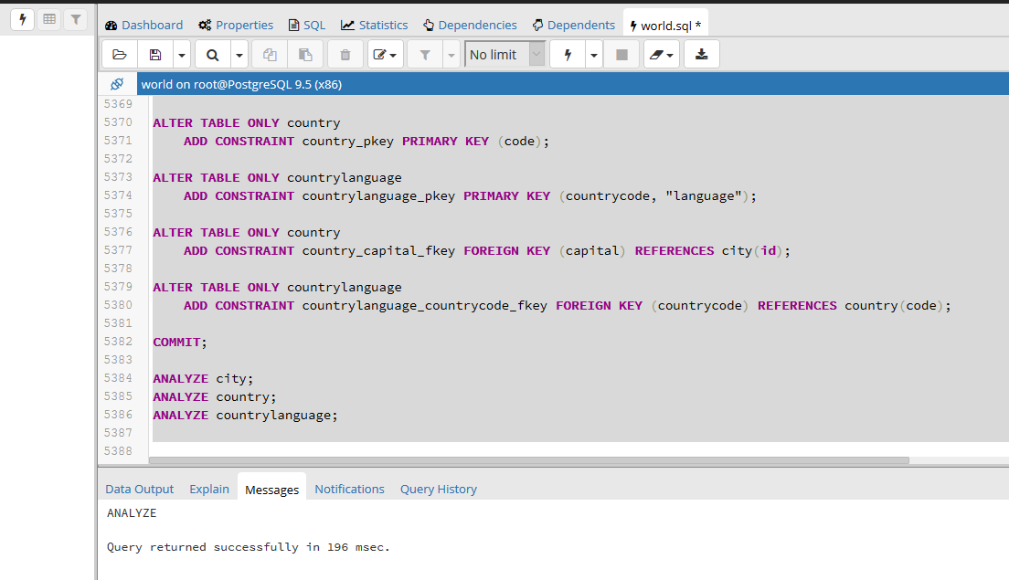
Import data from file using pgAdmin
Choose Restore…
Find sql file and execute it

Slide 6
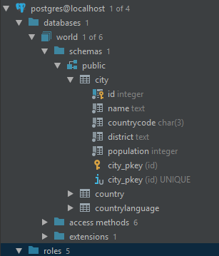
Import data from file using IntelliJ
Find file and execute all SQL
After success import
you will see something like that:

Slide 7
Open documentation Session 2\sample database\world_20190407_1313\index.html
Documentation generated by SchemaSpy
Analize

Slide 8
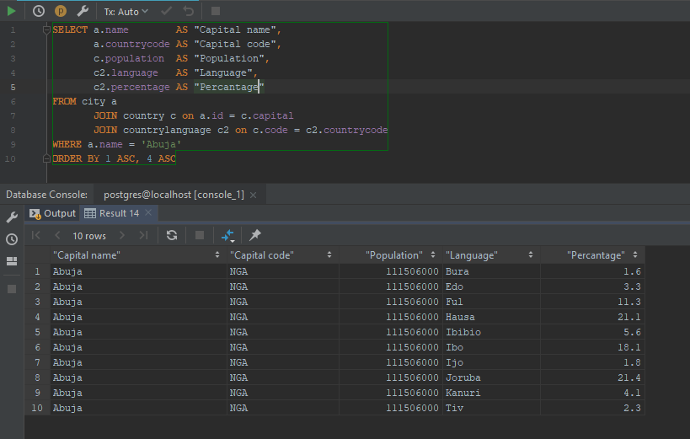
Let’s make some SQL’s

Slide 9
Task 1
Have previous SQL identify population count by language
Improve your results. Return result of population count group of English language for all countries. Show where English language is official and how many people speak on.

Slide 10

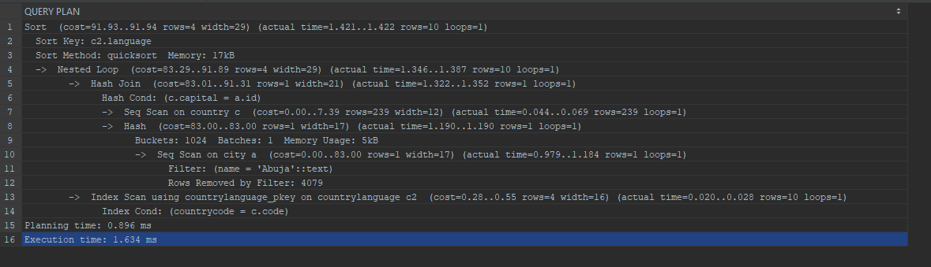
EXPLAIN ANALYZE

Slide 11
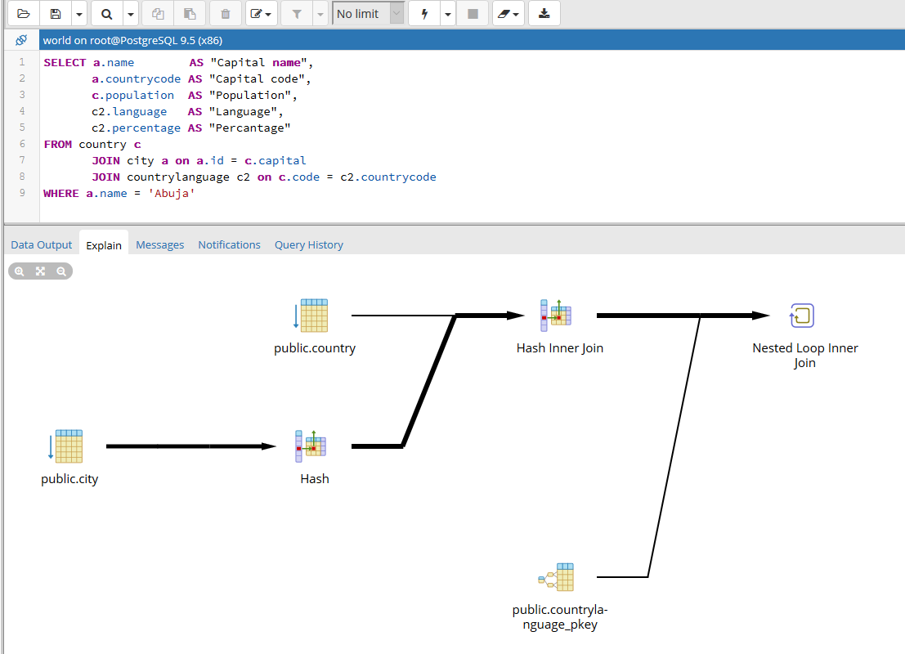
EXPLAIN ANALYZE

Slide 12
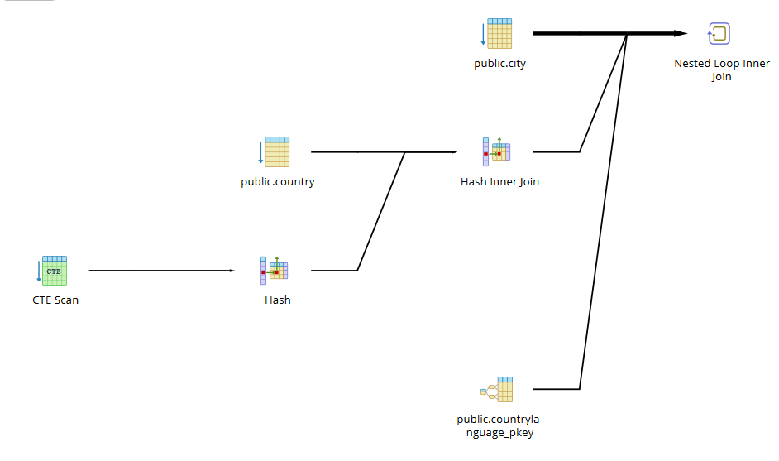
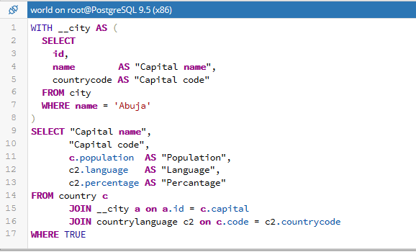
EXPLAIN ANALYZE

Slide 13
Function
Many logic could be created on functions. Having that we can use on backend side only simple MVC standard to set and get data to from database.
Let’s see example of function using plpgsql, which will return json result.

Slide 14
CREATE OR REPLACE FUNCTION public.fn_get_population_by(IN prm_capital_name character varying) RETURNS json AS $BODY$ BEGIN RETURN ( WITH __city AS ( SELECT id, name AS capitalName, countrycode AS capitalCode FROM city WHERE name = '' || prm_capital_name || '' ) , __data AS ( SELECT capitalName, capitalCode, c.population, c2.language, c2.percentage FROM country c JOIN __city a on a.id = c.capital JOIN countrylanguage c2 on c.code = c2.countrycode WHERE TRUE) SELECT json_agg(r.*) as json_data FROM __data AS r); END; $BODY$ LANGUAGE 'plpgsql’;

Slide 15
How to execute
It is simple:
Result of json you can check on http://json2table.com/
SELECT * FROM public.fn_get_population_by('Abuja')

Slide 16
Use your function on your java code
Add posgreSQL dependency
Make all required configurations to access your database
Use RestFul application to shown result in json format.

